Slide 1
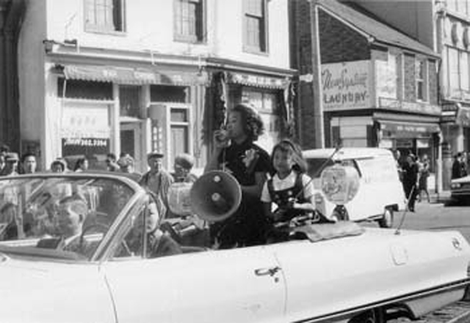
Toronto’s Chinatown
Jean Lumb Campaigns to Save Chinatown
Photo from the Multicultural History Society of Ontario
Notes:
Jean Lumb campaigning to save Chinatown

Slide 2
WHY History?
Movements for social justice:
people of Chinese heritage responding to racism
W-5 “Campus Giveaway” in 1979, Macleans“Too Asian?” in 2010
Chinese Canadian National Council (CCNC)
head tax reparations (Redress campaign, began 1984)
Asian and non-Asian academics like David Lai, Patricia Roy, Constance Backhouse, Lisa Rose Mar, Henry Yu
Community Historical Recognition Program (CHRP) funding – history as a tool for reparations, healing and change
Notes:
Redress
The modern era redress movement may be traced back to 1984, when Vancouver Member of Parliament (MP) Margaret Mitchell raised in the Canadian House of Commons the issue of repaying the Chinese Head Tax for two of her constituents.^{[13]} Over 4,000 other head tax payers and their family members then approached the Chinese Canadian National Council (CCNC) and its member organizations across Canada to register their Head Tax certificates and ask CCNC to represent them to lobby the government for redress.^{[14][15]} The redress campaign included holding community meetings, gathering support from other groups and prominent people, increasing the media profile, conducting research and published materials, making presentations at schools, etc.
In 1993, then prime minister Brian Mulroney made an offer of individual medallions, a museum wing, and other collective measures involving several other redress-seeking communities. These were rejected outright by the Chinese Canadian national groups. After Jean Chrétien, in the same year, replaced Mulroney as prime minister, the Cabinet openly refused to provide an apology or redress.^{[14]} Still, the CCNC and its supporters continued to raise the issue whenever they could, including a submission to the United Nations Human Rights Commission and eventually undertaking court action against the Crown-in-Council, arguing that the federal Crown should not be profiting from racism and that it had a responsibility under both the Canadian Charter of Rights and Freedoms and international human rights law. In addition, the 1988 apology and compensation for the internment of Japanese Canadians during the Second World War was regarded as a precedent for redressing other racially motivated policies. The Ontario court declared in 2001 that the government of Canada had no obligation to redress the head tax levied on Chinese immigrants because the Charter had no retroactive application and the case of internment of Japanese Canadians was not a legal precedent. Two appeals in 2002 and 2003 were unsuccessful.^{[16]}
When Paul Martin was appointed prime minister in 2003, there was a sense of urgency as it became clear that there were perhaps only a few dozen surviving Chinese Head Tax payers left and maybe a few hundred spouses or widows. Several national events were organised to revitalize the redress campaign:^{[17]} In 2004, Doudou Diène, the United Nations Special Rapporteur on Racism, Racial Discrimination, Xenophobia and Related Intolerance, concluded that Canada should redress the head tax to Chinese Canadians and, in 2005, Gim Wong, an 82-year-old son of two head tax payers and a World War II veteran, conducted a cross-country Ride for Redress on his Harley Davidson motorcycle.^{[18]}
[edit] Political campaigning
On November 17, 2005, a group calling itself the National Congress of Chinese Canadians announced that an agreement had been reached between 11 Chinese-Canadian groups and the federal Cabinet, wherein the Queen-in-Council would pay $12.5 million for the creation of a new non-profit foundation to educate Canadians about anti-Chinese discrimination, with a specific pre-condition that no apology would be expected from any government figure. This upset the CCNC and its affiliates, as this purported deal had been reached without their input, leading to the Department of Canadian Heritage's announcement on November 24, 2005, that the agreed upon funding would be reduced to $2.5 million. It was later revealed that Raymond Chan, the government official claiming to have negotiated the deal, had purposely misled both the ministers of the Crown and the public and some of the groups named as being party to the agreement stated publicly that their names had been used without permission; several other groups listed did not even exist. Regardless, bill C-333, a private member's bill, was tabled in the federal parliament in order to implement the deal in November, 2004, but this bill died when the government fell on November 28, 2005.
As they had done while campaigning for the federal election in 2004, the New Democratic Party and Bloc Québécois stated, during the leadup to the January 2006 election, their support for an apology and redress for the head tax.^{[citation needed]} Similarly, on December 8, 2005, Conservative Party leader, Stephen Harper, released a press statement expressing his support for an apology for the head tax. As a part of his party platform, Harper promised to work with the Chinese community on redress, should the Conservatives be called to form the next government.^{[19]} Before his party ultimately lost the election, Martin issued a personal apology on a Chinese language radio program. However, he was quickly criticized by the Chinese Canadian community for not issuing the apology in the House of Commons and for then trying to dismiss it completely in the English-speaking media on the very same day.^{[citation needed]} Several Liberal candidates with significant Chinese-Canadian populations in their ridings, including Vancouver-Kingsway MP David Emerson and the Minister of State for Multiculturalism and Richmond MP Raymond Chan, also made futile attempts to change their positions in the midst of the campaign.
[edit] Apology
The 2006 federal election was won by the Conservative Party, though the government they formed was a minority one. Three days after the ballots had been counted on January 23, but before he had been appointed prime minister, Harper reiterated his position on the head tax issue in a news conference: "Chinese Canadians are making an extraordinary impact on the building of our country. They've also made a significant historical contribution despite many obstacles. That's why, as I said during the election campaign, the Chinese Canadian community deserves an apology for the head tax and appropriate acknowledgement and redress."^{[20]}
Formal discussions on the form of apology and redress began on March 24, 2006, with a preliminary meeting between Chinese Canadians representing various groups (including some head tax payers), heritage minister Bev Oda, and Parliamentary Secretary to the Prime Minister Jason Kenney resulting in the "distinct possibility" of an apology being issued before July 1, 2006, to commemorate the anniversary of the enacting of the Chinese Exclusion Act of 1923.^{[21]} The meeting was followed by the government's acknowledgement, in the Speech from the Throne delivered by Governor General Michaëlle Jean on April 4, 2006, that an apology would be given along with proper redress.^{[22]}
From April 21 to April 30, 2006, the Crown-in-Council hosted public consultations across Canada, in cities most actively involved in the campaign: Halifax, Vancouver, Toronto, Edmonton, Montreal, and Winnipeg. They included the personal testimony of elders and representatives from a number of groups, among them the Halifax Redress Committee; the British Columbia Coalition of Head Tax Payers, Spouses and Descendants; ACCESS; the Ontario Coalition of Head Tax Payers and Families; the CCNC; the Edmonton Redress Committee of the Chinese Canadian Historical Association of Alberta; and the National Redress Alliance.
On June 22, 2006, Prime Minister Stephen Harper offered an apology and compensation only for the head tax once paid by Chinese immigrants.^{[23]} Survivors or their spouses were paid approximately CAD$20,000 ($22 thousand in 2011 dollars^{[11]}) in compensation. There were only an estimated 20 Chinese Canadians who paid the tax still alive in 2006.^{[24]}
[edit] Today
Currently, the major issues revolve around the content of any future settlement, with the leading groups demanding meaningful redress, not only for the handful of surviving "head tax" payers and widows/spouses, but first-generation sons/daughters who were direct victims.
Some^{[who?]} have proposed that the redress be based on the number of "Head Tax" Certificates (or estates) brought forward by surviving sons and daughters who are still able to register their claims, with proposals for individual redress, ranging from $10,000 to 30,000 for an estimated 4,000 registrants.
As no mention of redress for those children was made, the Chinese Canadian community continues to fight for a redress from the Canadian government. A national day of protest was held on July 1, 2006 in major cities across Canada, with several hundred Chinese Canadians joining in local marches.

Slide 3
RECENT PROJECTS
The Ties that Bind
Notes:
Uses oral history

Slide 4
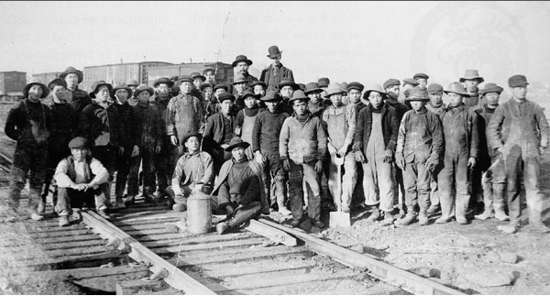
Chinese Canadian history
Notes:
The exploitation of the railway worker and those who were forced to pay the head tax have become symbols of these two aspects of our history.
Mostly about men because:
a) it was mostly men who were in Canada at the time
b) the purpose of history has been to show the important contributions people of Chinese heritage have made to the creation of the Canadian nation
c) these contributions tend to be about the railroad, restaurants and laundries.

Slide 5
Chinese Canadian History
Notes:
Another purpose: correct historical wrongs.

Slide 6
life Outside of Work is just as important
Was there “life outside of work”?
If we want to find out the history of social and family life we have to look to women’s history.
Incorrigible and Concubine’s Children
CHINESE CANADIAN WOMEN, 1923-1967: INSPIRATION-INNOVATION-INGENUITY
Is it possible to write a history of social and private life of men?
Notes:
What do we mean by private life? Everything outside of work! But even work was important because it was there that friends were made, plans to go out, information about places to visit were shared, and so on.
Is it possible? …We think it is possible. If the men will let us!

Slide 7
OBSTACLES
C U L T U R E A N D S T I G M A
Cultural taboos: do not talk about personal matters, even things like returning to China to find a wife.
Stigma: with few Chinese women living in Canada, sex workers and “low” (poor and racially or ethnically stigmatized) women were the earliest partners of Chinese men.
homosocial = homosexual? Another taboo, not just for the Chinese. But how to find out about that?

Slide 8
Obstacles: Sources
Notes:
Found this in my early research on the Continental Bar
-show images of the bar and items about the Chinese from the papers
-want to know more about this from the perspective of Chinese people

Slide 9
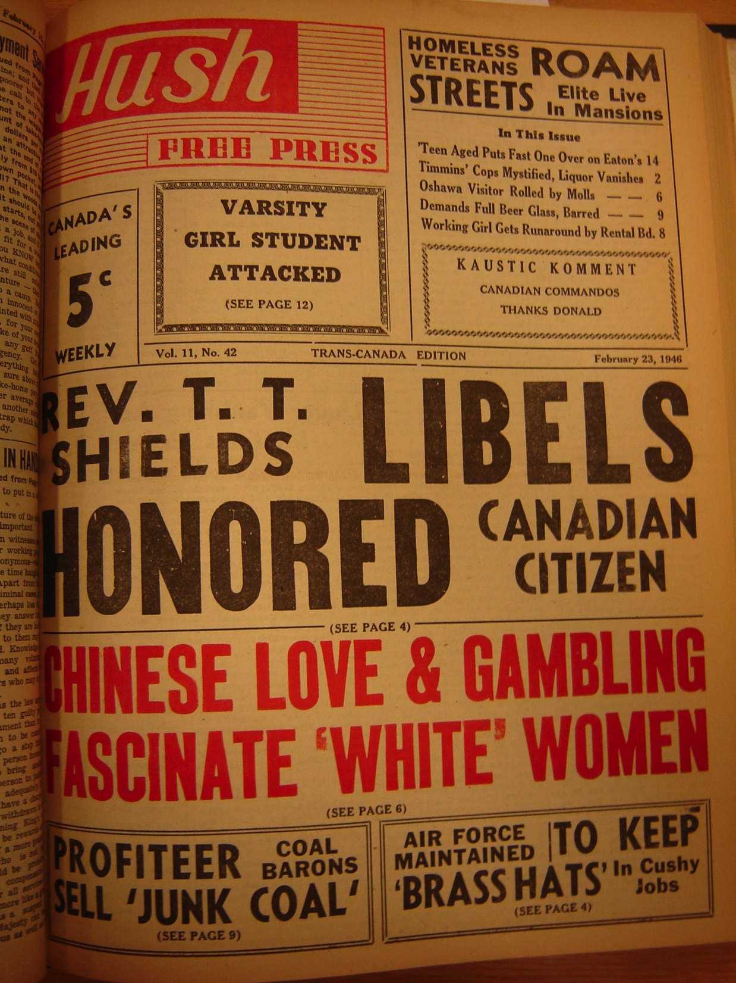

Slide 11
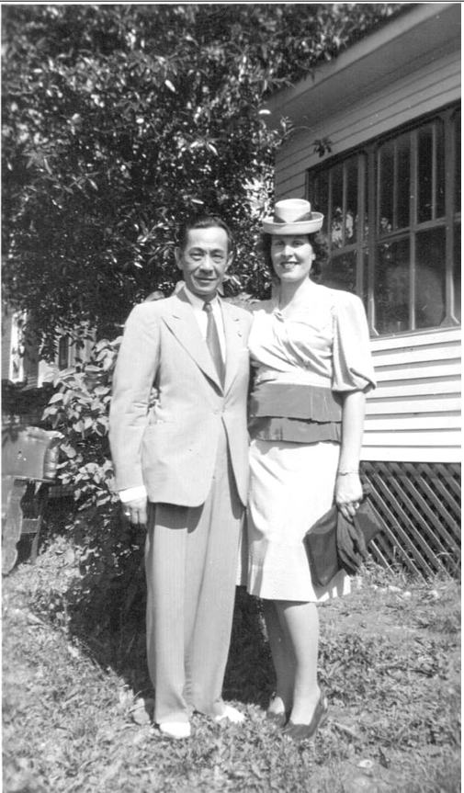
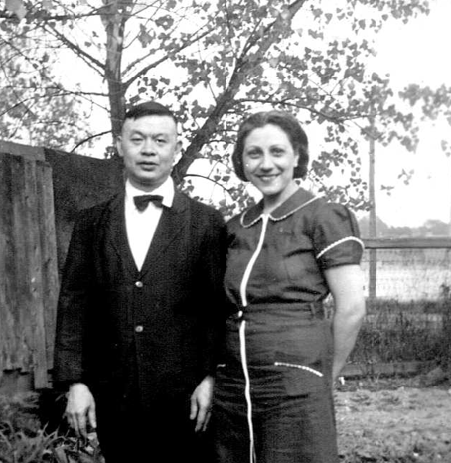
Interracial RelationSHips
Notes:
Mavis’ Mother and Father
DY Chu and his wife
Stanley and Rosalie Chu
Some of these relationships resulted in unwanted pregnancies, and many of these children were adopted into Chinese families. Gilbert Chu was one of those children, and here is what he told us:

Slide 12
Why Help?
Family and personal life can deepen our understanding of the experiences of people of Chinese heritage
This understanding will contribute to the social justice agenda by showing the personal impact of these policies;
It also leaves a history for your children and grandchildren, for other immigrant people.
If we don’t document it now, it will be lost forever.

Slide 13
How you can help
Volunteer to tell us about your own growing up experience, your family life and your social life in an interview.
Share with us your family and personal photos and other documents.
Tell your family, friends, and social networks about the project.

Slide 14
How can We help?
How can we share your stories, your history?
through presentations like this one?
on websites like The Ties that Bind?
in books?
other ways?

Slide 15
Save Chinatown!

